Slide 1
Geomorphological mapping of intertidal areas
Meng Lu
Utrecht University

Slide 2
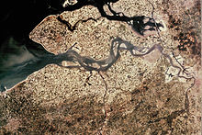
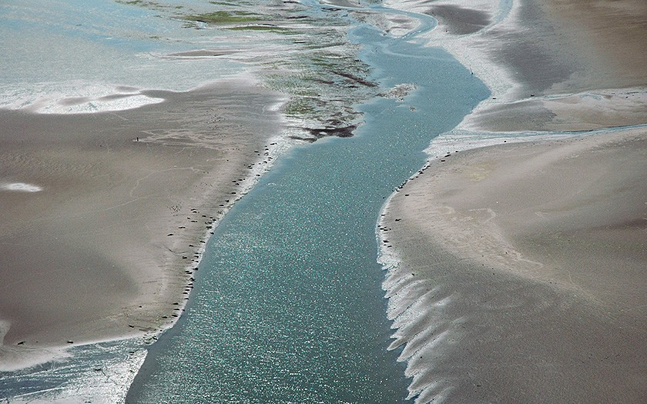
Geomorphological mapping of intertidal areas
Western Scheldt
Wadden Sea

Slide 3
Current state-of-the art
Challenging classes:
P1a Shoal flat low dynamics
P2c Shoal flat high dynamics
P2b Shoal Megaripples
Prediction
Ground truth
Differences

Slide 4
Objectives
Improve automatic geomorphological mapping on challenging groups (shoal flat low dynamics, shoal flat high dynamics, shoal Mega-ripples). Distinguishing between sandy and silty classes in Shoal flat low dynamics.
Understand which and how features contribute to the tidal area geomorphological mapping, with a focus on the challenging classes.
A comparison between OBIA- and deep neural networks-based methods in terms knowledge mining and to study the combination of them.

Slide 5
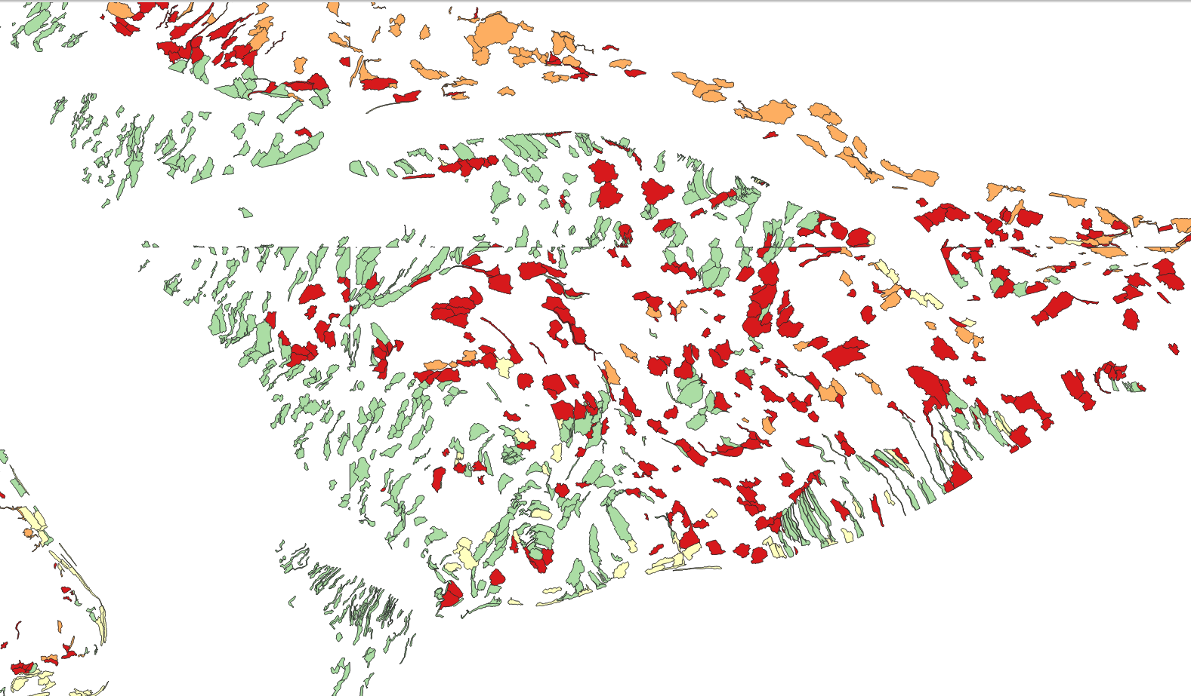
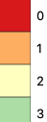
Method A
Segmenting -> classifying segmented features.
OBIA + XGBoost (Boosting trees with complexity control)
P1a1: Shoal flat low dynamics: sandy
P1a2: Shoal flat low dynamics: silty
P2c: Shoal flat high dynamics
P2b: Shoal megaripple

Slide 6
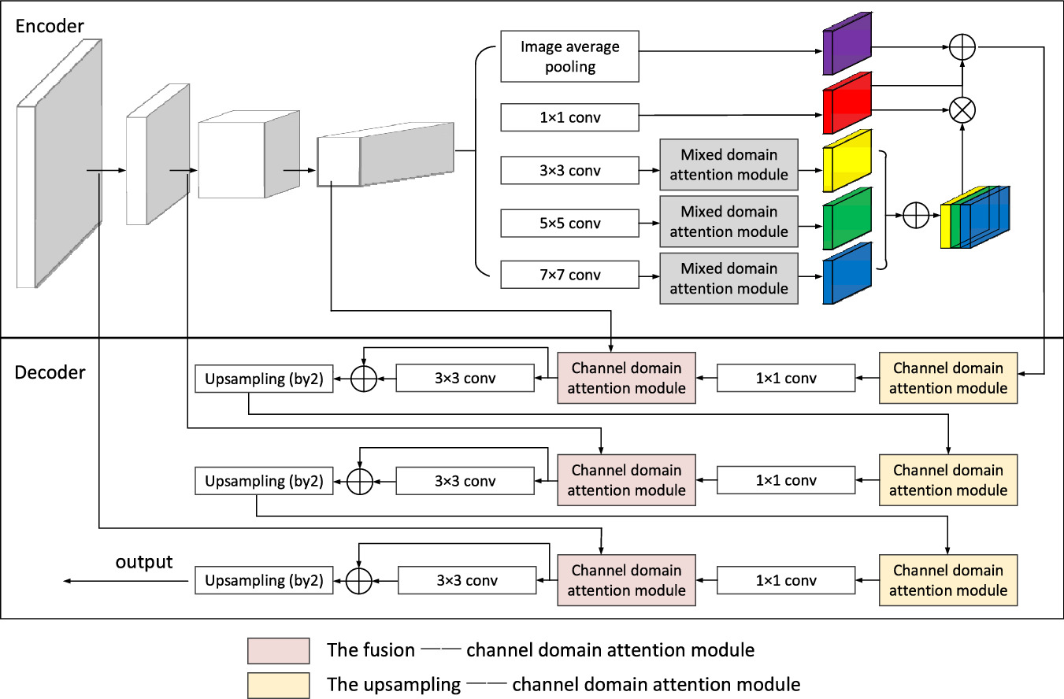
Method B
End-to-end deep neural network-based semantic segmentation
Aerial image: Red, Blue, NIR
Water, Vegetation indices, DEM
Expert manually classified map

Slide 7
Method C
Apply OBIA to the segmented output from deep neural networks to integrate prior knowledge
OBIA
Apply to

Slide 8
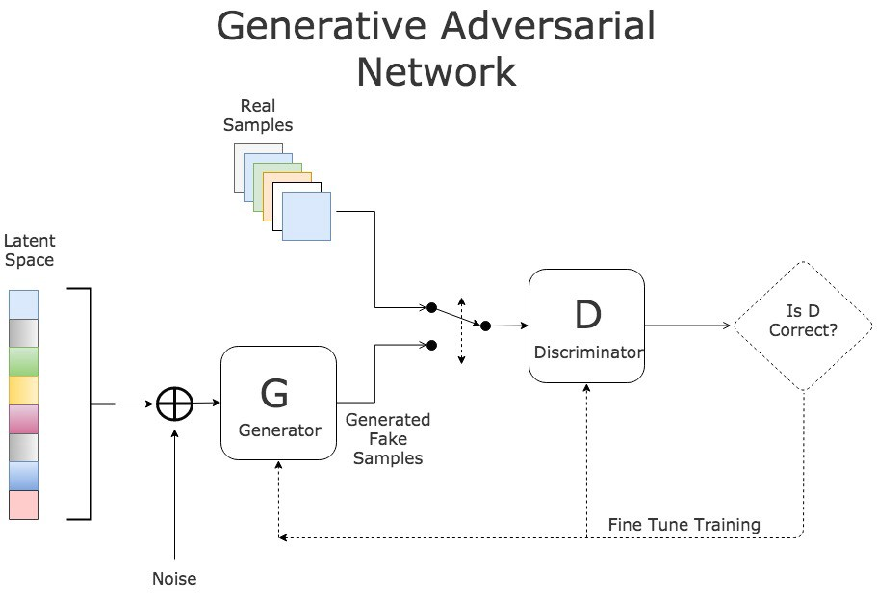
Feature enhancement
Applying generative models and image augmentation to enhance features in image pre-processing.

Slide 9
Model interpretability and feature analysis
Method A
Spatial segmentation units, variable contribution (e.g. partial dependence plot, variable importance), uncertainty
Method B and C
Interpreting features extracted at activation layers
Channel-attention modules to integrate and understand the impacts of spectral features and DEM
Spatial attention modules with dilated convolutions and multi-scale neural network architectures for the contextual features.

Slide 10
Comparison
OBIA | Deep Neural networks | note
Clear physical meanings of OBIA features | Represent learning
High interpretability | Harder to interpret | May provide omplementary information
Challenges in identifying spatial unit from OBIA. Natural integration of prior knowledge | End-to-end Harder to integrate prior knowledge | Compare with deep learning for segmenting
May be hard to generalise | Requires intensive model optimization and comparison

Slide 11
Impact
This study is both application- and method-driven.
It expects to gain us an in-depth understanding of features that contribute to tidal area classification and greatly improve the automation and prediction accuracy.
We emphasize model interpretability and knowledge mining. By comparing and combing OBIA- and deep learning-based models, this study contributes to the development and integration of both methodology domains for semantic segmentation.

Slide 12
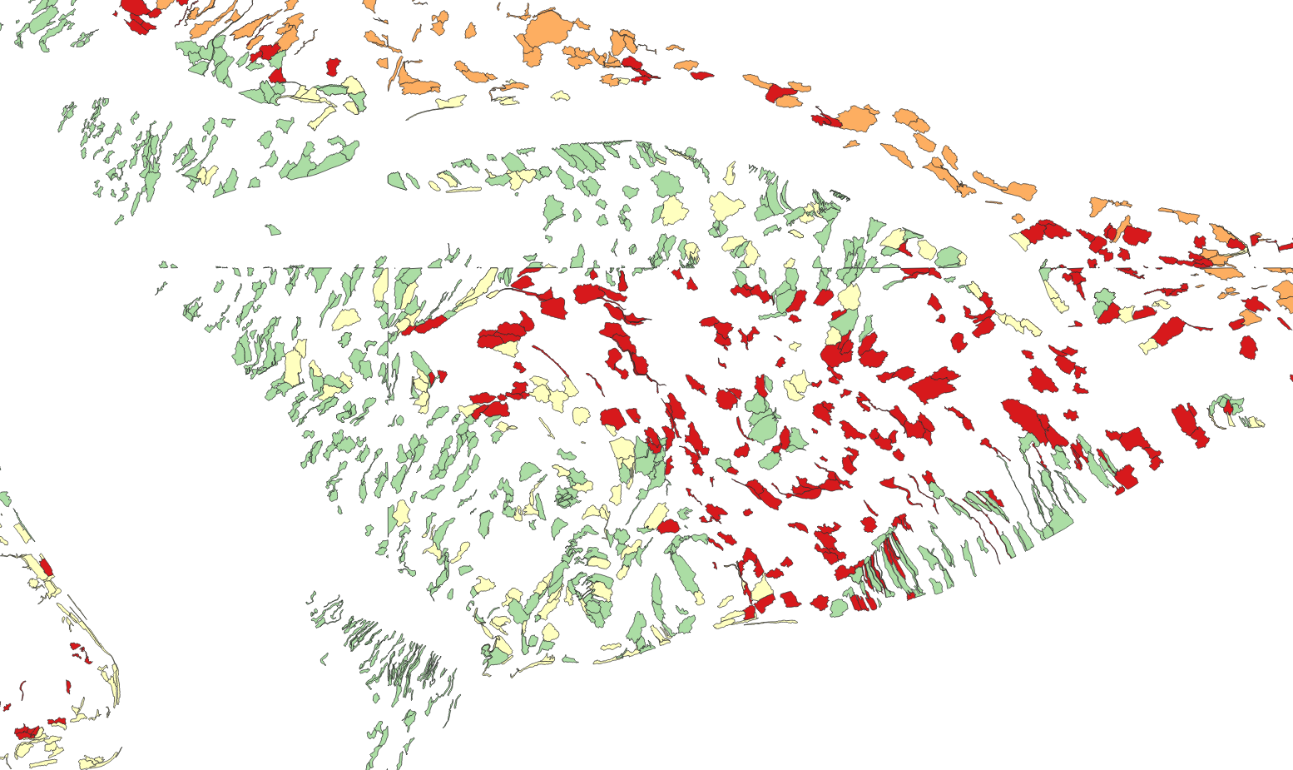
Preliminary results:
OBIA + XGBoost
Predicted
P1a1: Shoal flat low dynamics: sandy
P1a2: Shoal flat low dynamics: silty
P2c: Shoal flat high dynamics
P2b: Shoal megaripple
Ground truth

Slide 13
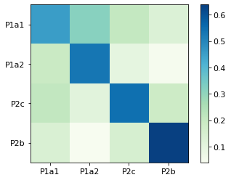
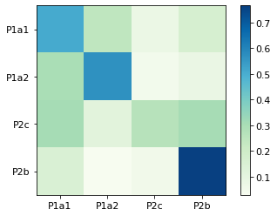

Preliminary results
Normalised by all the predicted truth
Diagonal: precision
Normalised by all the truth
Diagonal: recall

Slide 14
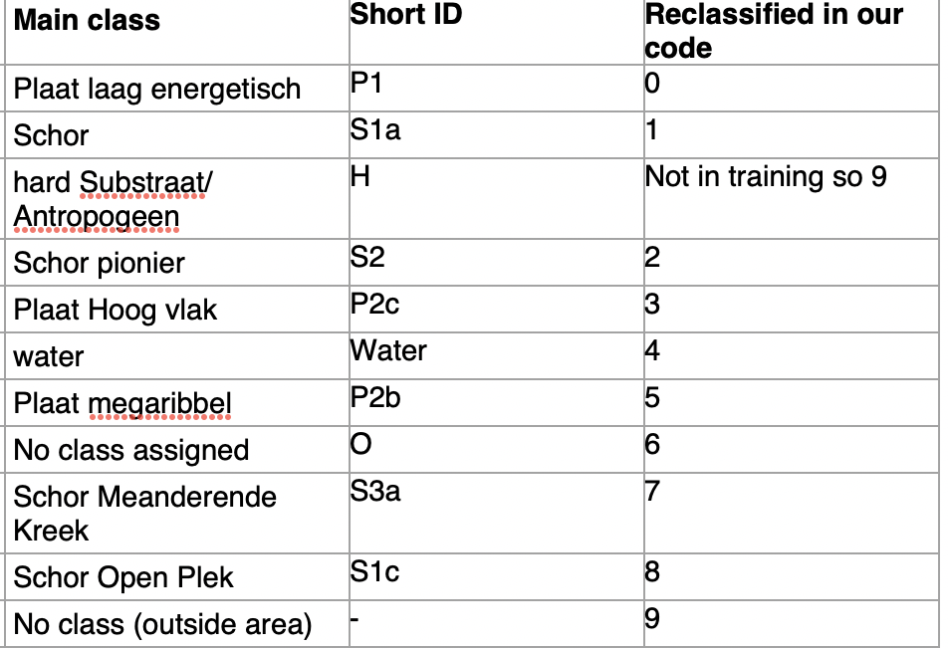
Preliminary results: deep learning-based semantic segmentation
An example tile: Shoal flat high dynamics is much less misclassified compared to OBIA
Currently optimal model:
Overall accuracy 90.4%, IoU 90.0%
Most challenging class
Mega ripples

Slide 15
Thank you!

Slide 16
precision: tp / (tp + fp)
recall: tp / (tp + fn)
 | Precision | Recall
P1a1 Shoal flat low dynamic: sand | 0.45 | 0.51
P1a2 Shoal flat low dynamic: silty | 0.53 | 0.57
P2c Shoal flat high dynamics | 0.55 | 0.27
P2b megaripple | 0.64 | 0.77
Overall | 54.44% | 54.65%
Accuracy: 54.65%
Tp: true positives
Fp: false positives
Fn: false negatives
P1a1: low energy sand
P1a2: low energy silt
P2c: high vlak
P2b: megaripple

